Slide 1

Deep Learning and Cognitive Therapy
CS598 Deep Learning for Healthcare
Michael Miller and Kurt Tuohy
5/6/2022
Reproducing paper:
Franziska Burger, Mark A. Neerincx, and Willem-Paul Brinkman. 2021.
Natural language processing for cognitive therapy: Extracting schemas from thought records.
PLOS ONE, 16(10).
Notes:
Hello. We are Michael Miller and Kurt Tuohy, students in CS 598 Deep Learning for Healthcare. Our project attempted to reproduce this paper in the field of cognitive therapy, and here we'll summarize our results.

Slide 2
Background
NLP not yet utilized for psychological care
Difficult
High cost for mistakes
Potential high value
“Schemas” are categories for core beliefs
Currently, schemas manually predicted
Premise: use NLP and Deep Learning to predict schemas
Notes:
Text analysis has not been used much in cognitive therapy, partly because of the high cost of mistakes. But the field is open and there's value to be gained. The authors of this paper worked to set initial benchmarks for NLP performance.
The authors built models to classify automatic thoughts into schemas. In cognitive therapy, automatic thoughts underly reactions to situations that generate emotion. Schemas are the mental frameworks through which each person views the world.

Slide 3




Experimental Setup
Scenario
Automatic Thought
Schema
“You’ve been dieting for a week, but you gained a pound.”
Attachment
“I have no self-control.”
Power & Control
Competence
Meta-Cognition
Other People
Notes:
The authors scripted scenarios and asked volunteers to record their reactions, as illustrated here. For example, "I've been dieting, but I gained a pound" can elicit automatic thoughts like "I have no self-control." The authors then built models to classify these utterances into 9 types of schemas.

Slide 4
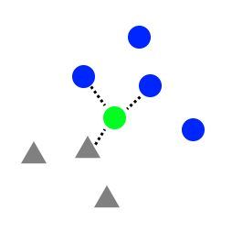


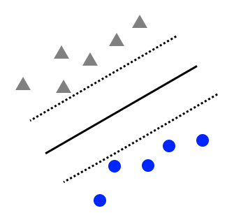

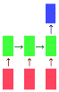
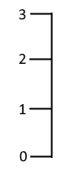
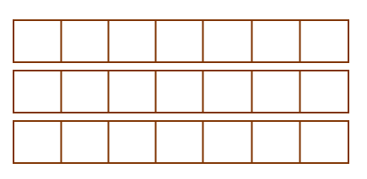

Preprocessing and Prediction
Utterances
GLoVe Embeddings
Models
Schemas
kNN
Classify by schema
Utterance-level
“I have no self-control.”
SVM
“I can’t accomplish my goals.”
Predict single schema rating
Word-level
LSTM
Notes:
The authors built 4 types of models. They used classical kNN and Support Vector Machines to establish baseline performance, then used two types of bidirectional LSTMs. One LSTM classified each utterance as one of nine schemas. The other type of LSTM rated utterance correspondence with a single schema.

Slide 5
Scope of Reproducibility
Attempt to recreate the four original model types
Use different python packages
Use different design choices with judgement
Test two additional hypothesis
Relaxed preprocessing
Scenario level utterances
Notes:
We reimplemented all these models. We used PyTorch for LSTMs instead of the original Keras/Tensorflow implementation. We also used some different design choices. For example, we implemented custom tokenization and learning rates.
Finally, we tested two additional hypotheses. We performed custom relaxed preprocessing of utterances, and we generated scenario-level embeddings for utterances.

Slide 6

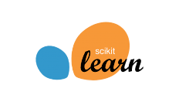

Results
At high level, results support hypothesis
Simpler models (KNN, SVM) close matches
More complicated models (RNNs) match less closely
Differences are a result of model changes, design changes. For example:
Tokenization, padding
Learning rate
Loss calculation
As a result, individual claims not verified
Notes:
Now we'll talk about our results, along with some broader implications of the paper.
At a high level, our results supported the initial hypothesis. Given utterances, were able to successfully predict the schema.
However, our results weren't perfect. Our classical models gave results that were very close to what the authors got. However, our more complicated RNNs matched less closely.
That makes sense. The differences were a result of the fact that we used different Python modules and some design changes. For example, we used different tokenization and padding, different learning rates, and a different loss calculation.
As a result of these differences, we were not able to verify the claims we made at the top of our paper.

Slide 7
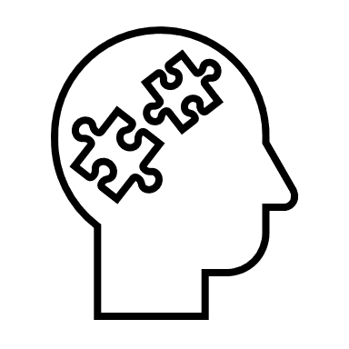

Discussion
Easy:
Straightforward access to code, data
Excellent documentation
Difficult:
Code community tend to rely on standard packages
Difficult to perfectly recreate results
Results point to potential confounding variables
Results suggest future research in psychology is worthwhile
Notes:
Finally, a broader discussion. Things we found to be easy included our straightforward access to the original code and data. The authors did a great job of documenting their work, and we really appreciated that.
What was difficult stemmed from the fact that the Python code community relies on different standard packages to do tasks. Since we intentionally switched packages, we found it hard to adapt the code to another purpose.
As we've said, we also found it difficult to exactly match some of the results. We talked about some of the reasons for this.
The fact that we got different results points to some possible confounding factors. For example, there might not be enough data, or the data might not have enough variety.
But it also suggests this field has potential, and there's value in more work applying AI to cognitive therapy.

